Slide 1
GW Nissan Portal
Project Development Update
GW - IT Department
17-01-2018

Slide 2
Modules
Dashboard
Shows the notifications and policies, claims graphs.
Policy Managment
Input Policy, Search Policy
Claim Managment
Process Claim, Search Claim
Security
Management of Users and Roles.
Report
Policies and Claim Reports.

Slide 3
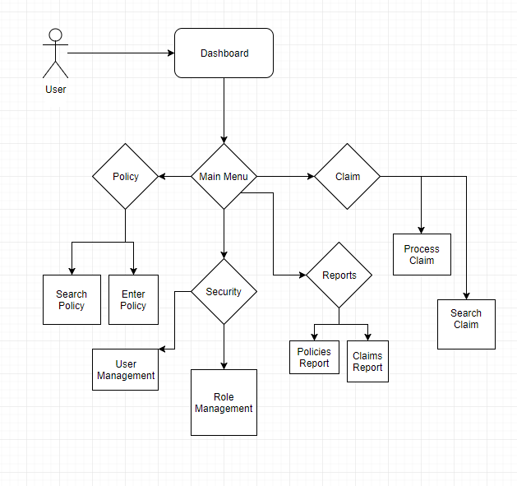
System Flow

Slide 4
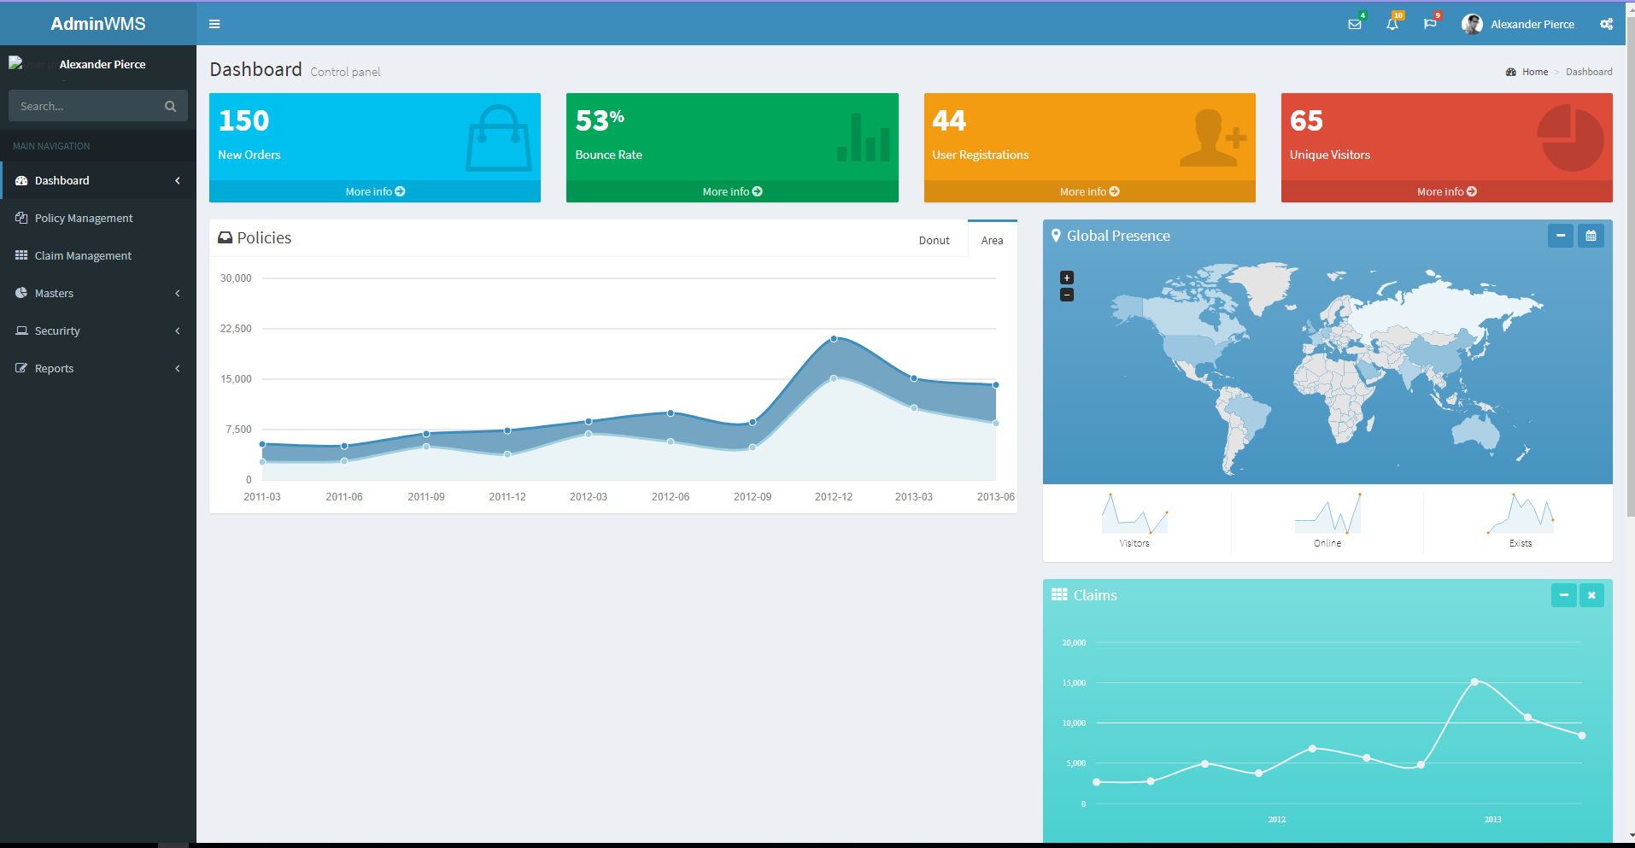
Main Screen

Slide 5
Development Status
Modules | Status
Dashboard | UI (80%) , Backend (70%)
Policy | Backend(30%)
Claim | Backend(30%)
Security | Backend(40%)
Reports | Backend(10%)

Slide 6
The End

